Slide 1
WELCOME TO
SRI LANKA

Slide 2
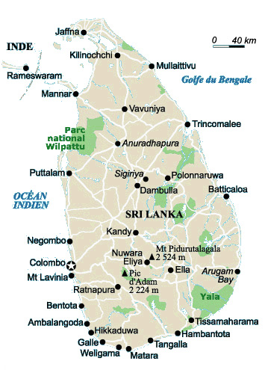

Slide 3
Population | 20,926,315 million
Population Density | 309 people per sq km
Life Expectancy at Birth | 74 Female, 64 Male
Literacy rate | 91.8%
Voltage / Power Supply | 230/240 volts AC, 50Hz. Round tree-pin plugs are usual, with bayonet lamp fittings.
Languages | Sinhala, Tamil and English are widely spoken throughout Sri Lanka, with the exception of remote villages where it might be Sinhala only or Tamil only.
Ethnic Groups | Sinhalese - 74%; Tami l- 18%; Muslim -7% ; Burgher (descendants of Dutch and Portuguese colonist) and others - 1%
Religions | Buddhism - 70% ; Hinduism - 16 %; Christianity - 7 %; Islam - 7 %
Climate | Low Lands – tropical, average 27° C Central Hills – cooler, with temperatures dropping to 14° C. The south-west monsoon brings rain to the western, southern and central regions from May to July, while the north-eastern monsoon is from December to January. Sri Lanka climate is ideal for holiday-makers throughout the year.

Slide 4
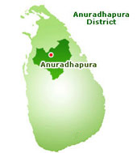
ANCIENT CITIES
UNESCO WORLD HERITAGE SITES
Anuradhapura

Slide 5
Anuradhapura
The first capital of Sri Lanka – and remaining so for 1,400 years – Anuradhapura was abandoned and swallowed by the dry-zone jungle two centuries after Vijayabahu I had retaken the country and retained the Cholas capital at Polonnaruwa in the 11th Century.
The only thing that has managed to live – literally – throughout the centuries, carefully attended by guardians all this time, is the sacred Bo Tree, the Sri Maha Bodhi, grown from a sampling of the Bodhi tree under which the Buddha attained enlightenment. The original Bodhi tree has since died, but the Sri Maha Bodhi survives and has been worshipped for 23 centuries, making it the oldest tree in the world.
The significance of this tree attests to the widespread influence of Buddhism, of which the surviving shrines of the ancient city provide more visible evidence. These dome-shaped monuments of worship are known as dagobas or stupas, and notable ones include the Ruwanweli Seya, Thuparamaya and Jetavanarama and Abhayagiri Dagoba.

Slide 6
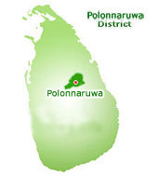
ANCIENT CITIES
UNESCO WORLD HERITAGE SITES
Polonnawura

Slide 7
Polonnawura
As early as the 7th Century, when Anuradhapura was still the capital, Sri Lankan kings had made Polonnaruwa their country retreat. With the Cholas’ conquest of Anuradhapura in the 11th Century, Polonnaruwa succeeded it as the capital and remained so for the next 200 years - even when Vijayabahu I eventually defeated the South Indian invaders.
The relatively short history of this capital makes it easy for you to explore all the ruins and if you are inclined towards a hard day of walking under a sweltering sun, you could even discover the city on foot. If not, there is always ready transport, with a guide at your ear.

Slide 8
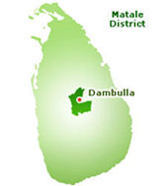
ANCIENT CITIES
UNESCO WORLD HERITAGE SITES
Dambulla

Slide 9
Dambulla
About 12 miles from Sigiriya you’ll come to the Raja Maha Vihara, otherwise known as the Dambulla Cave Temple or Golden Temple. This is actually a series of five temples that finds its origin in the Anuradhapura period (1st Century B.C.), even though the art works that have survived to this day are mostly representative of the Kandyan period (18th Century) due to restoration efforts. These caves used to be places of refuge and have been embellished by several kings throughout Sinhalese history. Be awed by the 157 statues of Buddha and royalty, as well as intricate wall and ceiling frescoes of both religious and secular nature. Look out especially for the ceiling paintings in the fourth cave, which follow the folds of the rock so closely that they have been mistaken for cloth paintings stuck onto the ceiling.

Slide 10
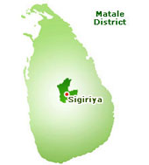
ANCIENT CITIES
UNESCO WORLD HERITAGE SITES
Sirigiya

Slide 11
Sirigiya
Desperation can also drive a man to greatness. It must have been a mixture of fear and guilt for having his own father slain and stealing the throne from right under his half brother's nose that motivated King Kasyapa to erect this magnificent fortress – 'Palace in the Sky' – in the 5th Century A.D. The rock rises out of nowhere, towering 600 feet above you. From the base you can't see the palace, which means you'll have to climb the equivalent of 75 floors up. A fairly healthy person would need about two hours to get up and down, but once you're up there, you'll find that just being on top looking down at the vast forest below is well worth the climb.

Slide 12
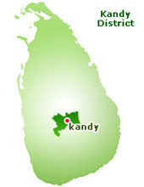
PLACES NOT TO MISS
Kandy

Slide 13
Kandy
As the last major capital of the Sinhala kings, Kandy is definitely a place not to be missed if you want your Sri Lanka trip to be complete.
If you have no time for anything else, at least visit the Dalada Maligawa, or Temple of the Tooth, where the sacred Tooth Relic of Buddha is housed. The tooth was brought to Sri Lanka in the 4th Century A.D., hidden in a princess' hair. Since then it has changed homes several times, and was relocated to Kandy in 1590 where it has stayed to this day.
Other places of interest include the Royal Botanical Gardens, which are flanked by Mahaweli, the longest river of Sri Lanka, and used to be the Royal Pleasure Gardens of the Kandyan Kings. Then there is the King's Palace, an important stronghold of Kandy's last ruler, Sri Wickrama Rajasinghe, and Ul-Pan-Ge or the Queen's Bath.
Kandy Lake is the setting of Kandy Esala Perahera (the "Festival of the August Moon"), which takes place every July or August and is the most spectacular celebration in the country. It's an event not to be missed!

Slide 14
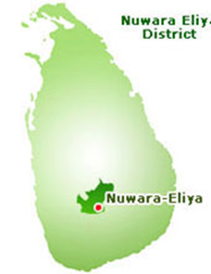
PLACES NOT TO MISS
Niwara Eliya

Slide 15
Niwara Eliya
Nuwara Eliya (City of Lights), also known as 'Little' England', was the favourite hill station of the British who tried to create Eliya Nuwara Eliya Post office into a typical English Village. The old brick Post office, country house like hill club, with it's hunting pictures, mounted hunting trophies and fish, and it's strict formal dinner attire; the 18 hole golf course, race course etc., all remind you of 'England'.. It is located at an altitude of 1,868 m (6,128 ft) in the central highlands and is considered one of the most important locations for Tea production in Sri Lanka. The town is overlooked by Pidurutalagala, the highest mountain in Sri Lanka.Sri Lankans celebrate their National New Year Aluth Avurudu in mid april after the Harvest is done. The sun moving from the House of Pisces to the Aries signals the dawning of the Sinhala and Tamil New Year. The New Year begins at the time determined by the astrologers.
Due to the high altitude, Nuwara Eliya has a much cooler climate than the lowlands of Sri Lanka, with a mean annual temperature of 16 °C. But the temperature changes and sometimes it can be like 3°C. In the winter months it is quite cold at night, and there can even be frost.

Slide 16
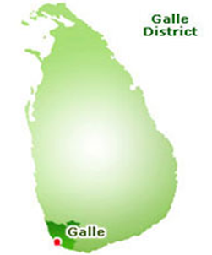
PLACES NOT TO MISS
Galle

Slide 17
Galle
Galle is situated in the Southern part of Sri Lanka, approximately about 116 kilometers to the south from the capital city, Sri Jayewardenepura Kotte, or in other words, about 108 kilometers to the south of Colombo. Galle is the capital city of the Southern Province of Sri Lanka, and is the home for nearly a one million population. Today’s town has grown greatly and spreads into the hinterland but the Fort is the slow-beating heart of Galle’s history.
The walled city has stood since the early sixteenth century, through the Colonial periods of the Portuguese, Dutch and British and in our present times is proclaimed as an Archaeological Reserve and been identified as a World Heritage site.

Slide 18
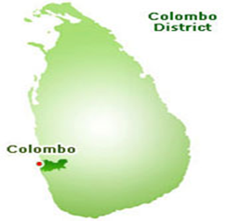
PLACES NOT TO MISS
Colombo

Slide 19
Colombo
Colombo is the largest city and commercial capital of Sri Lanka. It is located on the west coast of the island and adjacent to Sri Jayawardenepura Kotte, the capital city of Sri Lanka. Colombo is a busy and vibrant city with a mixture of modern life and colonial buildings and ruins and a city population of 647,100.
The main shopping center for the locals is Pettah where the markets are busy and bustling. The main branch of Laksala, Sri Lanka’s largest handicrafts shop is at Fort. More up market shopping destinations are towards the south of the city center along the Galle Road. Majestic City, Liberty Plaza and Crescat are popular among the locals where you could find handicrafts, tea and garments. Odel at Lipton Circus offers good quality items such as clothes, shoes, tea, books and leather goods in a fashionable setting.

Slide 20
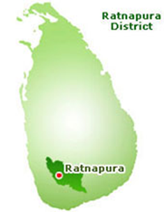
PLACES NOT TO MISS
Ratnapura (The City of Gems)

Slide 21
Ratnapura
The of the town depends on the gem trade. Gem pits are a common site in the surrounding area. Most of the large-scale gem businessmen of Sri Lanka operate from Ratnapura. There are considerable numbers of foreign gem traders in town too. Among the foreign traders, Thailand traders are in the majority. Every day, large number of traders from suburbs and other towns gather in the town centre to sell or buy gemstones. Large-scale merchants collect gemstones from locals and sell them in the international market. Some traders go out of the city to buy gems.

Slide 22
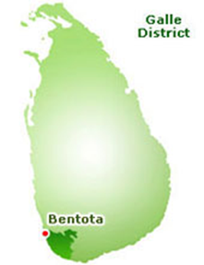
PLACES NOT TO MISS
Bentota

Slide 23
Bentota
A Sri Lankan coastal city famous for golden beaches, Bentota is situated on the southern coastal tip of the Galle District of the Southern Province. The town is a popular tourist attraction. It is especially famous among the foreign tourists. The name comes from a mythical story which dates back to kings time saying a demon called Bem ruled this river.
Bentota hosts a handful of world proclaimed hotels. It is the hosting land for the famous Sri Lankan Jeweler Aida. Bentota also delivers an ancient art of healing called Ayurveda. Bentota is also famous for its production in Toddy - an alcoholic beverage made out of coconut nectar. The city's population is estimated to be between 25,000-50,000. Bentota was heavily damaged by the 2004 Indian Ocean Tsunami which devastated the Sri Lankan coastal belt on the morning of the December 26th.

Slide 24
PLACES NOT TO MISS
Hikkaduwa

Slide 25
Hikkaduwa
Hikkaduwa is a small town on the south coast of Sri Lanka. It is located in the Southern Province, about 20 km north-west of Galle. Hikkaduwa is famous for its beach and corals. Coral Sanctuary is the main attraction of Hikkaduwa. A lot of tourist come here for enjoying this Natural Beauty. A couple of hundred meters from the shore there is a rocky area, which is also visible from Corel Garden hotel, is a large shallow area enclosed by the reef. To reach the shore from where you can swim to this reef is just a mins walk from the Corel Garden hotel's beach area .

Slide 26
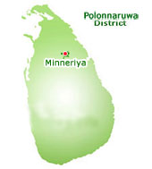
NATIONAL PARKS
Minneriya

Slide 27
Minneriya
A flapping sea of black invades the emerald Minneriya Tank, as a flock of two thousand cormorants nosedive for fish. Later, elephants trudge by, drinking from the same reservoir. You want to be present to witness it, and you can, a jeep safari from Deer Park Hotel takes you there in a jiffy. Not nearly the largest tank in Sri Lanka, Minneriya Tank - with the woods that surround it forming the Minneriya-Giritale National Park - is nevertheless home to an extraordinary diversity of wildlife. If numbers interest you, there are nine species of amphibians, 24 species of mammals, 25 species of reptiles, 26 species of fish (three of which are endangered), 75 species of butterflies and 160 species of birds. Making your way through the park, you will see elephants, Spotted Deer and also the Sambar, which is a deer with no spots and an apt scientific name, cerves unicolor. If you're lucky (or for some, unlucky), a leopard looking for food might cross your path. Other creatures you may not care to meet include the Sloth Bear, Indian Python and the Mugger Crocodile, also known as Tank Crocodile.

Slide 28
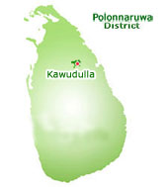
NATIONAL PARKS
Kawudulla

Slide 29
Kawudulla
Kawudulla National Park is Sri Lanka 's newest national park (opened in 2002) and is located off the main Habarana - Trincomalee road in the ancient cities' area (Cultural Triangle). The park has established a 6656-hectare elephant corridor between Somawathie Chaitiya and Minneriya National Parks . The best time to visit the park is between August and December. The park is centred on ancient Kawudulla Tank (reservoir) and is home to up to 250 Elephants (including herds of juvenile males), Leopard, Fishing cat, Sloth bear, Sambar deer, and the endangered Rusty spotted cat.
With fantastic opportunities to see many elephants at close range, the park has become a popular destination for wildlife safaris that also take in leopards, sambar deer and the occasional sloth bear! As an additional novelty, you can go for cataraman rides on the tank.

Slide 30
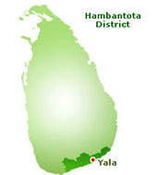
NATIONAL PARKS
Yala

Slide 31
Yala
The biggest national park, whose Block 1 – one of the five areas open to public – has one of the world’s densest leopard populations. There are only 35 leopards residing here, but it’s probably the best place in the world to catch one, in the wild, on film. To see the entire park could take you at least three days, though there is a one-day jeep-trip available. The types of life you’ll encounter here are too numerous to list: better to see them for yourself.
Yala National Park is situated in the southeast region of the island in the dry zone boarding the Indian Ocean. Park area is belonging to two provinces namely South and Uva Provinces. The total area of the park (which is of 5 blocks) is 97,881 ha but only Block I and Block II are open for visitors.
All the big game mammals of the country are found within the park. Elephant, Leopard, sloth bear, Spotted Dear, Wild Boar and sambhur. Apart from them small mammals such as Black naped hare, Grey, Ruddy & Striped necked mongoose, Grey Langur & porcupine are common small mammals.
Park is also famous for its abundant bird life. Over140 species have recorded so far within the park.

Slide 32
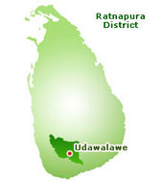
NATIONAL PARKS
Udawalawe

Slide 33
Udawalawe
Likened to an African game reserve, the Uda Walawe National Park is probably one of the most impressive nature parks in the country. About 106 miles southeast of Colombo, the park houses an estimated 500 elephants, of which you can see up to 100 at a time. The Uda Walawe Reservoir in the middle of the park serves the animals. Catch the Spotted Deer, Sambar, Water Buffalo, Mongoose, Bandicoot, Toque Monkey and Grey Langur in addition to foxes, crocodiles, wild boars, leopards and 30 varieties of snakes. If you dare - that is.

Slide 34
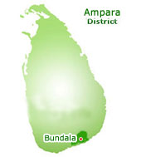
NATIONAL PARKS
Bundala

Slide 35
Bundala
Bundala National Park is situated in the southeast part of the country in the semi arid zone. Park belongs to Southern Province. The park area is 6,216 hectares.The park was initially established as a Sanctuary in 1969. Due to its significant role as a wintering site for migratory birds this was declared as RAMSAR wetland in 1990.
Bundala National Park is mainly consist of 4 brackish lagoons, salt pans, marshes, thorny scrub lands, sand dunes, dry mixed ever green forests and dry grass lands. Park provides the shelter for Elephant, Spotted Dear, Wild Boar, Black naped hare, Grey & Ruddy mongoose, toque macaque, Grey Langur & porcupine, jackal and fishing & Rusty Spotted cats. This park is also well known for sightings of estuarine crocodile and mugger crocodile.
The main attraction of the Bundala is the birdlife, especially waders. There are both resident and migratory species. Greater Flamingo, Spot-billed Pelican, Lesser Adjutant and Black-necked Stork are among the large birds. Large flocks of terns, gulls, sand-pipers, snipes, teals, cormorants, egrets and many more water birds are commonly seen

Slide 36
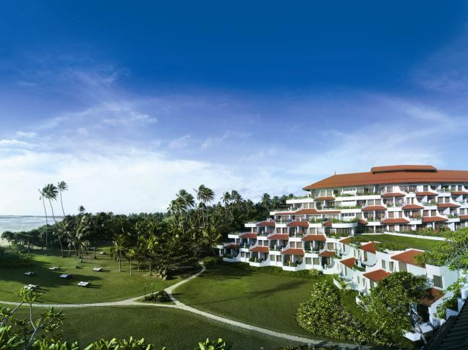
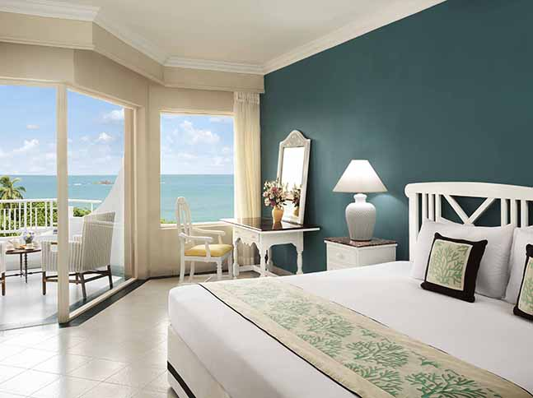
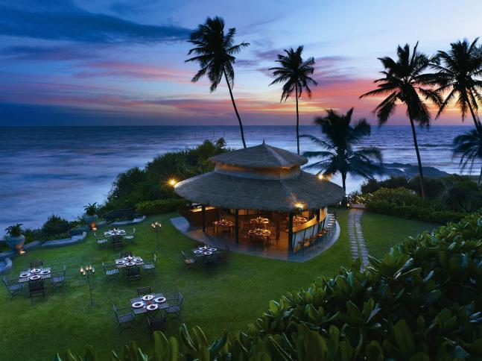
Hotels
&
Resorts

Slide 37
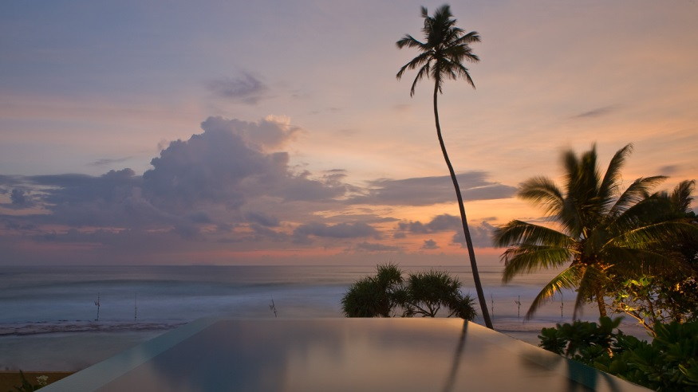
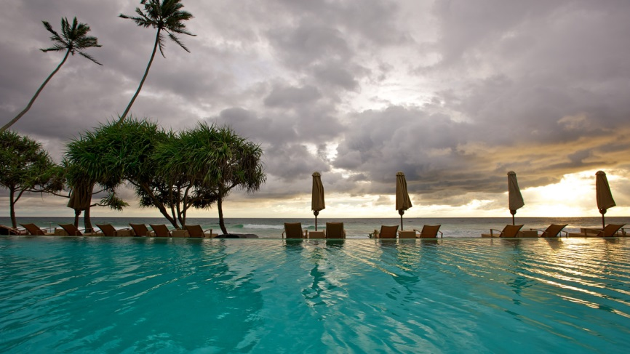
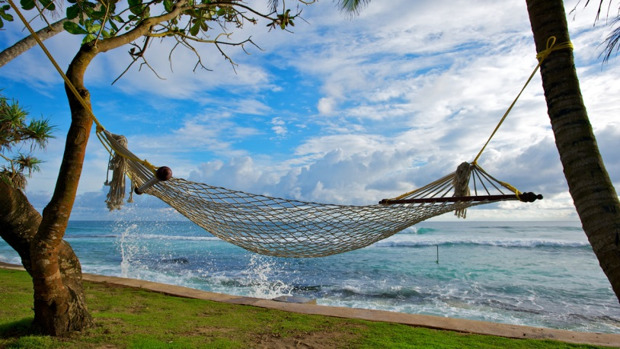
Hotels
&
Resorts

Slide 38
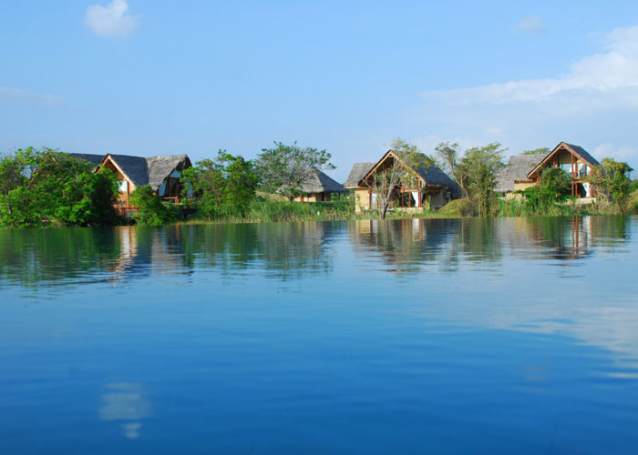
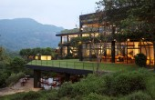
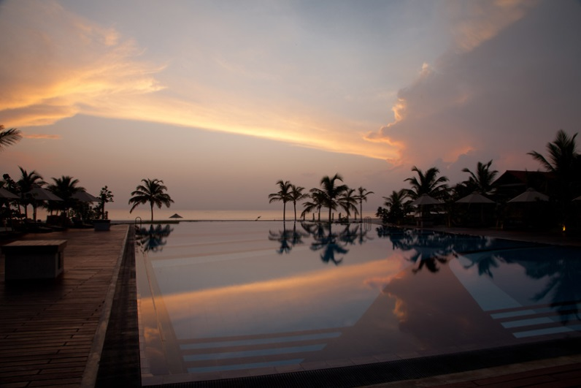
Hotels
&
Resorts

Slide 39
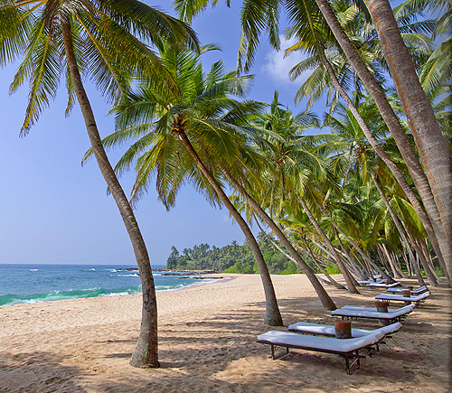
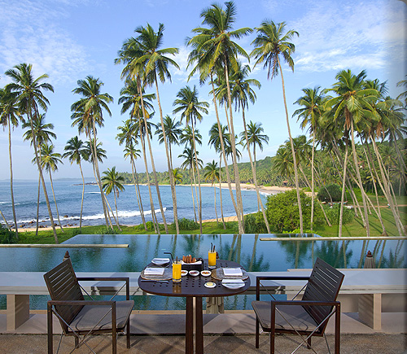
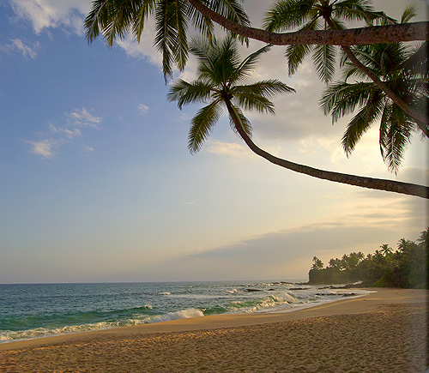
Hotels
&
Resorts

Slide 40
Recommended Hotels & Resorts
5 Star Hotels
Colombo The Kingsbury Hotel Cinnamon Grand Cinnamon Lake side Colombo Hilton Taj Samudra | Beach Blue water Hotel, Wadduwa Cinnamon Bey, Beruwala Vivanta By Taj, Bentota Heritance Ahungalla, Ahungalla The Fortress, Koggala Amanwella, Tangalle Jetwing Beach, Negombo Uga bay, Passikudah | Round Tour Ulagalla resort, Thirappane Vil Uyana, Sigiriya Heritance Kandalama, Kandalama Earls Regency, Kandy Mahaweli Reach, Kandy

Slide 41
Recommended Hotels & Resorts
4 Star Hotels
Colombo Ramada Hotel Galadari Hotel Mount Lavinia Hotel Gateway By Taj Seeduwa | Beach The Sands Hotel, Kalutara Avani Kalutara Hotel, Kalutara Eden Resort & Spa, Beruwala Cinnamon Beach, Bentota Chaaya Tranz, Kikkaduwa Mandara Resort, Mirissa Ranna 212, Tangalle Jetwing Blue, Negombo Club Hotel Dolphin, Waikkal Ananthaya Resort, Chilaw Maalu Maalu Resort, Passikudah Amaya beach, Passikudah | Round Tour Aliya Resort, Sigiriya Amaya Lake, Dambulla Cinnamon Lodge, Habarana Chaaya Village, Habarana Deer Park Hotel, Giritale Amaya Hills, Kandy Cinnamon Citadel, Kandy HeritanceTea Factory, Kandapola Grand Hotel, Nuwara Eliya Cinnamon Wild , Yala Jetwing Yala, Yala Mandara Rosen, Kataragama

Slide 42
Recommended Hotels & Resorts
3 Star Hotels
Colombo Grand Oriental Hotel | Beach Mermaid Hotel, Kalutara Tangerine Hotel, Kalutara Club Bentota, Bentota Unawatuna Beach resort, Unawatuna Dickwella Resort, Dickwella Nilaweli beach, Nilaweli | Round Tour Camelia Resort, Sigiriya Sigiriya Village,Sigiriya Topaz Hotel, Kandy Hotel Tree of Life, Kandy Saint Andrews Hotel, Nuwara Eliya Priyankara Hotel, Tissamaharama

